Slide 1
Introduction to Algorithm Design
Lecture Notes 10

Slide 2
ROAD MAP
Greedy Technique
  Knapsack Problem
  Minimum Spanning Tree Problem
    Prim’s Algorithm
    Kruskal’s Algorithm
  Single Source Shortest Paths
    Dijkstra’s Algorithm
  Job Sequencing With Deadlines
  Huffman Trees
  Activity Selection Problem

Slide 3
Greedy Technique
Used for solving optimization problems
  such as engineering problems
Construct a solution through a sequence of decision steps
  Each expanding a partially constructed solution
  Until a complete solution is reached
Similar to dynamic programming
  but, not all possible solutions are explored

Slide 4
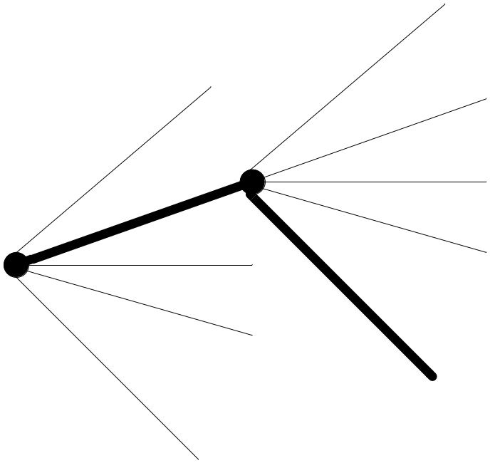
Greedy Technique
On each decision step the choice should be
Feasible
  has to satisfy the problem’s constraints
Locally optimal
  has to be the best local choice
Irrevocable
  once made, it can not be changed

Slide 5
Greedy Technique
Greedy Algorithm ( a [ 1 .. N ] )
{
solution = Ø
for i = 1 to n
x = select (a)
if feasible ( solution, x )
solution = solution U {x}
return solution
}

Slide 6
Greedy Technique
In each step, greedy technique suggests a greedy selection of the best alternative avaliable
  Feasible decision
  Locally optimal decision
  Hope to yield a globally optimal solution
Greedy technique does not give the optimal solution for all problems
There are problems for which a sequence of locally optimal choices does not yield an optimal solution
  EX: TSP, Graph coloring
  Produces approximate solution

Slide 7
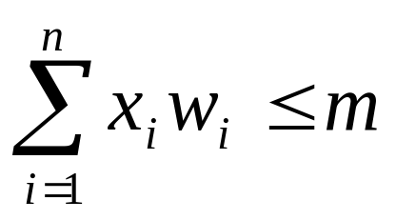
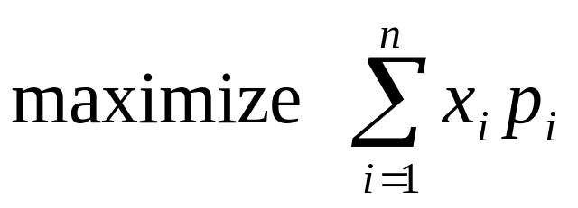
Fractional Knapsack Problem
Given :
  w_{i} : weight of object i
  m : capacity of knapsack
  p_{i} : profit of all of i is taken
Find:
  x_{i} : fraction of i taken
Feasibility:
Optimality:

Slide 8
Greedy Technique
Greedy Algorithm ( a [ 1 .. N ] )
{
solution = Ø
for i = 1 to n
x = select (a)
if feasible ( solution, x )
solution = solution U {x}
return solution
}

Slide 9
Knapsack Problem
Algorithm Knapsack (m,n)
for i = 1 to n
x(i) = 0
for i = 1 to n
select the object (j) with largest unit value
if (w[j] < m)
x[j] = 1.0
m = m – w[j]
else
x[j] = m/w[j]
break
Example :
M = 20 n = 3
p = (25, 24, 15) w = (18, 15, 10)

Slide 10
Proof of Optimality
G is greedy solution
G = x₁, x₂, …, x_{n} 0 ≤ x_{i} ≤ 1
let x_{k} ≠ 1 k: least index
x_{i} = 1 1 ≤ i < k
x_{i} = 0 k < i ≤ n
O is optimal solution
O = y₁, y₂, …, y_{n}
let x_{j} ≠ y_{j} j is the least index
y_{j} < x_{j}

Slide 11
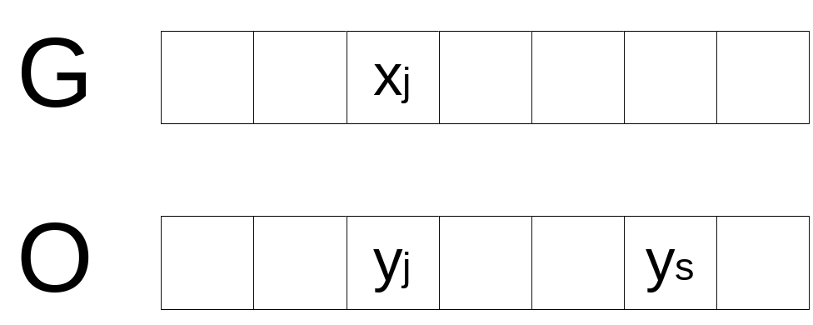
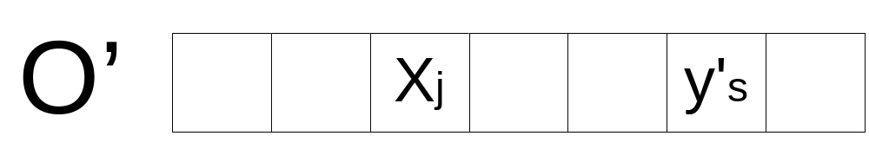
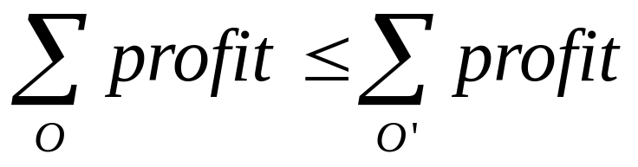

y_{j} ← x_{j}
y_{j} ← y_{j} + x_{j} – y_{j}
y_{s} ← y’_{s}
O → O’
O → O’ →O’’ → … → G

Slide 12


Minimum Spanning Tree (MST)
Problem Instance:
  A weighted, connected, undirected graph G (V, E)
Definition:
  A spanning tree of a connected graph is its connected acyclic subgraph
  A minimum spanning tree of a weighted connected graph is its spanning tree of the smallest weight
    weight of a tree is defined as the sum of the weights on all its edges
Feasible Solution:
  A spanning tree G’ of G

Slide 13
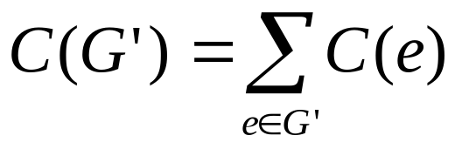
Minimum Spanning Tree
Objective function :
  Sum of all edge costs in G’
Optimum Solution :
  Minimum cost spanning tree

Slide 14
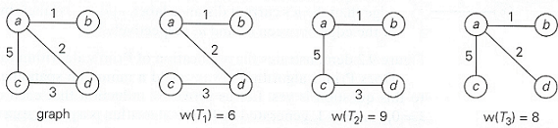
Minimum Spanning Tree
T₁ is the minimum spanning tree

Slide 15
Greedy Technique
Greedy Algorithm ( a [ 1 .. N ] )
{
solution = Ø
for i = 1 to n
x = select (a)
if feasible ( solution, x )
solution = solution U {x}
return solution
}

Slide 16
Prim’s Algorithm
Prim’s algorithm constructs a MST through a sequence of expanding subtrees
Greedy choice :
  Choose minimum cost edge add it to the subgraph

Slide 17
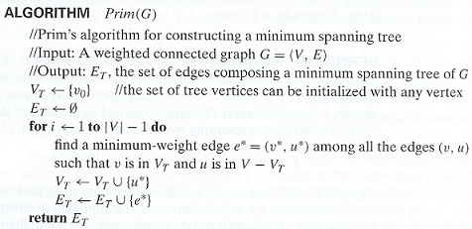
Prim’s Algorithm

Slide 18
Prim’s Algorithm
Approach :
  1. Each vertex j keeps near[j] Є T (current tree)
  where cost(j,near[j]) is minimum
  2. near[j] = 0 if j Є T
  = ∞ if there is no egde between j and T
  3. Use a heap to select minimum of all edges

Slide 19
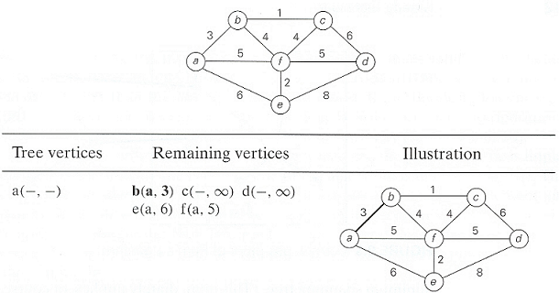
Prim’s Algorithm Example

Slide 20
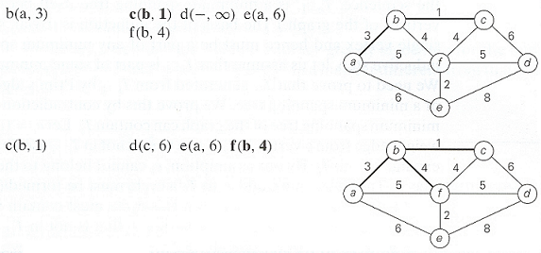
Prim’s Algorithm Example

Slide 21
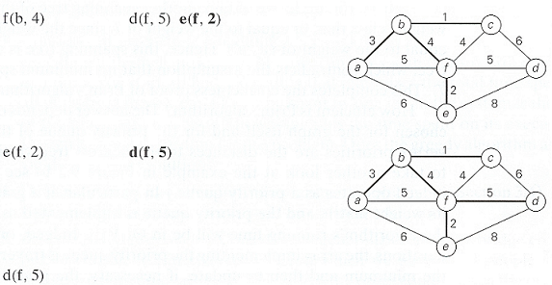
Prim’s Algorithm Example

Slide 22
Correctness proof of Prim’s Algorithm
Prim’s algorithm always yield a MST
We can prove it by induction
  T₀ is a part of any MST
    consists of a single vertex
  Assume that T_{i-1} is a part of MST
  We need to prove that T_{i}, generated by T_{i-1} by Prim’s algorithm is a part of a MST
  We prove it by contradiction
    Assume that no MST of the graph can contain T_{i}

Slide 23
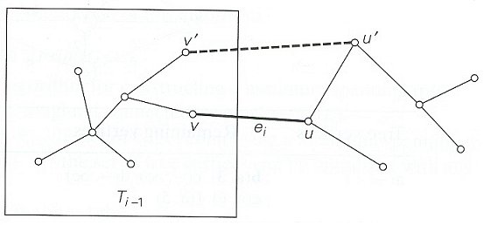
Let e_{i}=(u,v) be minimum weight edge from a vertex in T_{i-1} to a vertex not in T_{i-1} used by Prim’s algorithm to expant T_{i-1} to T_{i}
By our assumption, if we add e_{i} to T (MST), a cycle must be formed.
In addition to e_{i}, cycle must contain another edge (v’, u’).
If we delete the edge e_{k}, (v’, u’), we obtain another spanning tree
w_{ei} ≤ w_{ek} So weight of new spanning tree is less or equal to T. Since T is a MST, weight of new spanning tree can not be less. So, they are equal.
New spanning tree is a minimum spanning tree which contradicts the assumption that no minimum spanning tree contains T_{i}

Slide 24
Prim’s Algorithm
Initialize S with the start vertex, s, and V–S with the remaining vertices
for all v in V – S
if there is an edge (s, v)
Set cost[v] to w(s, v)
Set next[v] to s
else
Set cost[v] to ∞
Set next[v] to NULL
while V – S is not empty
for all u in V – S, find the smallest cost[u]
Remove u from V – S and add it to S
Insert the edge (u, next[u]) into the spanning tree.
for all v adjacent to u in V – S
if w(u, v) < cost[v]
Set cost[v] to w(u, v)
Set next[v] to u.

Slide 25
Prim’s Algorithm
Analysis :
How efficient is Prim’s algorithm ?
  It depends on the data structure chosen
  running time is Θ(|V|²) If
    graph is represented by its weight matrix
    unordered array is used
  running time of is O(|E|log|V|) If
    graph is represented by adjacency list
    priority queue such as a min-heap is used

Slide 26
Kruskal’s Algorithm
Another algorithm to construct MST
Expands a subgraph
  initially contains all the vertices but no edges
Generates a sequence of subgraphs
  always acyclic
  not necessarily connected
Resulting graph is connected and acyclic (i.e., tree)
Greedy choice :
Choose minimum cost edge
  Connecting two disconnected subgraphs
It always yields an optimal solution

Slide 27
Greedy Technique
Greedy Algorithm ( a [ 1 .. N ] )
{
solution = Ø
for i = 1 to n
x = select (a)
if feasible ( solution, x )
solution = solution U {x}
return solution
}

Slide 28
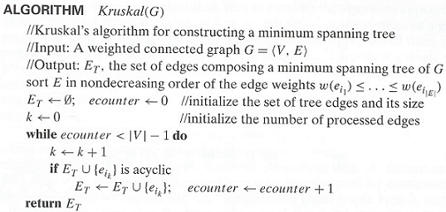
Kruskal’s Algorithm

Slide 29
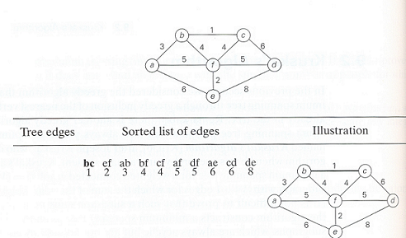
Kruskal’s Algorithm Example

Slide 30
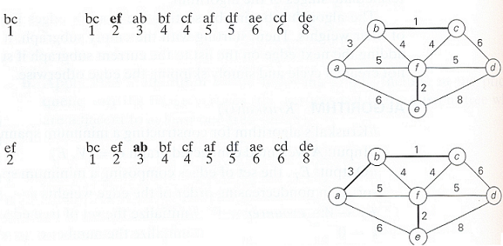
Kruskal’s Algorithm Example

Slide 31
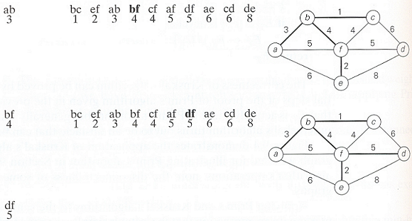
Kruskal’s Algorithm Example

Slide 32
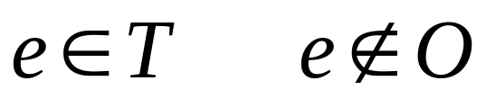
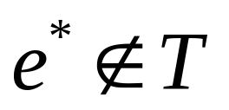
Proof of Optimality
Algorithm → T not optimal
e₁, e₂, …, e_{n-1} c(e₁) < c(e₂) < …< c(e_{n-1})
O is optimal
O U {e} forms a cycle
The cycle contains an edge
O’=O U {e} – {e*} forms another spanning tree
Cost(O’) = Cost(O) + c(e) - c(e*)
Greedy choice → c(e) ≤ c(e*)
Cost(O’) ≤ Cost(O)
O→ O’ →… → O^{(k)} =T

Slide 33
Disjoint Subsets and
Union-Find Algorithms
Some applications (such as Kruskal’s algorithm) requires a dynamic partition of some n-element set S into a collection of disjoint subsets S₁, S₂, …, S_{k}
After being initialized as a collection n one-element subsets, each containing a different element of S, the collection is subjected to a sequence of intermixed union and find operations

Slide 34
Disjoint Subsets and
Union-Find Algorithms
We are dealing with an abstract data type of a collection of disjoint subsets of a finite set with operations :
  makeset(x) :
    creates one-element set {x}
    it is assumed that this operation can be applied to each of the element of set S only once
  find(x) :
    returns a subset containing x
  union (x,y) :
    constructs the union of disjoint subsets S_{x}, S_{y} containing x and y, respectively
    Adds it to the collection to replace S_{x} and S_{y}
      which are deleted from it

Slide 35
Disjoint Subsets and
Union-Find Algorithms
Example :
  S = { 1, 2, 3, 4, 5, 6 }
    make(i) creates the set(i)
    applying this operation six times initializes the structure to the collection of six singleton sets :
    {1}, {2}, {3}, {4}, {5}, {6}
    performing union (1,4) and union (5,2) yields
    {1, 4}, {5, 2}, {3}, {6}
    if followed by union (4,5) and then by union (3,6)
    {1, 4, 5, 2}, {3, 6}

Slide 36
Disjoint Subsets and
Union-Find Algorithms
There are two principal alternatives for implementing this data structure
  1. quick find
    optimizes the time efficiency of the find operation
  2. quick union
    optimizes the union operation

Slide 37
Disjoint Subsets and
Union-Find Algorithms
1. quick find
  optimizes the time efficiency of the find operation
  uses an array indexed by the elements of the underlying set S
  each subset is implemented as a linked list whose header contains the pointers to the first and last elements of the list

Slide 38
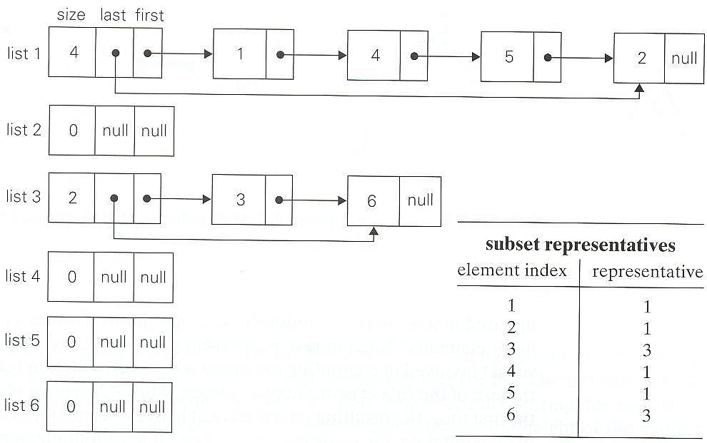
Linked list representation of subsets {1, 4, 5 ,2} and {3, 6} obtained by quick-find after performing union (1,4), union (5,2), union (4,5) and union (3,6)

Slide 39
Disjoint Subsets and
Union-Find Algorithms
Time efficency of makeset(x) is Θ(1), hence initialization of n singleton subsets is Θ(n)
Time efficency of find(x) is Θ(1)
Executing union(x,y) takes longer,
  Θ(n²) for a sequence of n union operations
  A simple way to improve the overall efficiency is to append the shorter of the two lists to the longer one
  This modification is called union-by-size
  But it does not improve the worst case efficiency

Slide 40
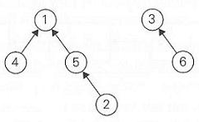
Disjoint Subsets and
Union-Find Algorithms
2. quick union
  Represents each subsets by a rooted tree
  The nodes of the tree contain the subset’s elements (one per node)
  Tree’s edges are directed from children to their parents

Slide 41
Disjoint Subsets and
Union-Find Algorithms
2. quick union
  Time efficency of makeset(x) is Θ(1), hence initialization of n singleton subsets is Θ(n)
  Time efficency of find(x) is Θ(n)
    A tree representing a subset can degenerate into a linked list with n nodes
    A find is performed by following the pointer chain from the node containing x to the tree’s root
  Executing union (x,y) takes Θ(1)
    It is implemented by attaching the root of the y’s tree to the root of the x’s tree

Slide 42
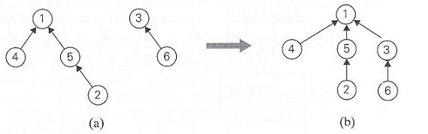
Disjoint Subsets and
Union-Find Algorithms
a ) forest representation of subsets {1, 4, 5, 2} & {3, 6} used by quick union
b) result of union (5,6)

Slide 43
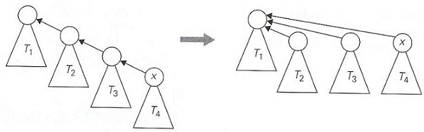
Disjoint Subsets and
Union-Find Algorithms
A better efficiency can be obtained by using path compression
  Every node encountered during the execution of a find operation are made to point to the tree’s root
A sequence of n-1 unions and m finds takes only slightly worse than linear

Slide 44
Kruskal’s Algorithm
Algorithm requires at most n-1 unions and 2m finds
Analysis → O(|E| log|E|)

Slide 45
ROAD MAP
Greedy Technique
  Knapsack Problem
  Job Sequencing With Deadlines
  Minimum Spanning Tree Problem
    Prim’s Algorithm
    Kruskal’s Algorithm
  Single Source Shortest Paths
    Dijkstra’s Algorithm
  Huffman Trees
  Activity Selection Problem

Slide 46
Greedy Technique
Construct a solution through a sequence of decision steps
  Each expanding a partially constructed solution
  Until a complete solution is reached
On each decision step the choice should be
  Feasible : has to satisfy the problem’s constraints
  Locally optimal: has to be the best local choice
  Irrevocable : once made, can not be changed

Slide 47
Greedy Technique
Greedy Algorithm ( a [ 1 .. N ] )
{
solution = Ø
for i = 1 to n
x = select (a)
if feasible ( solution, x )
solution = solution U {x}
return solution
}

Slide 48
Single Source Shortest Paths
Definition:
  For a given vertex called source in a weighted connected graph, find shortest paths to all other vertices in the graph

Slide 49
Dijkstra’s Algorithm
Idea :
  Incrementally add nodes to an empty tree
  Each time add a node that has the smallest path length
Approach :
  1. S = { }
  2. Initialize dist [v] for all v
3. Insert v with min dist[v] in T
4. Update dist[w] for all w not in S

Slide 50
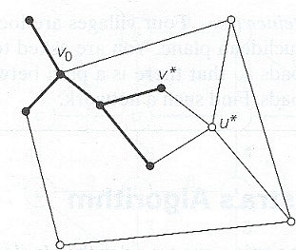
Dijkstra’s Algorithm
Idea of Dijkstra’s algorithm

Slide 51
Greedy Technique
Greedy Algorithm ( a [ 1 .. N ] )
{
solution = Ø
for i = 1 to n
x = select (a)
if feasible ( solution, x )
solution = solution U {x}
return solution
}

Slide 52
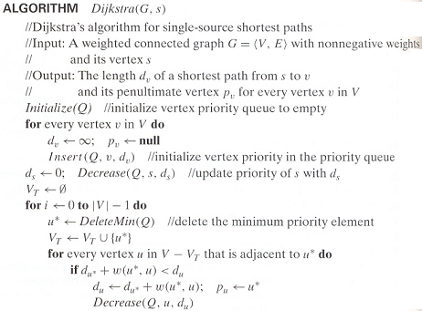

Slide 53
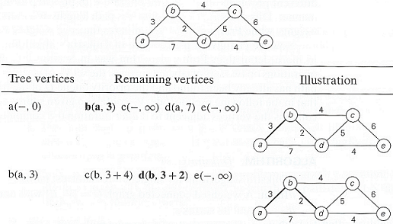
Dijkstra’s Algorithm Example

Slide 54
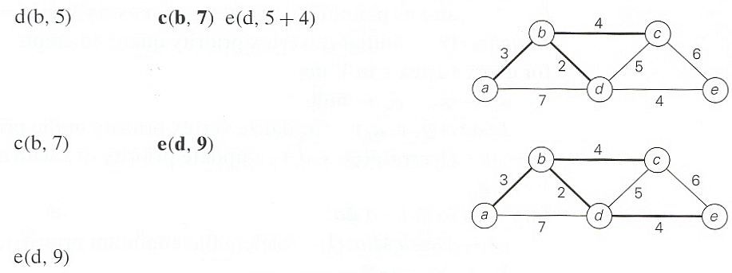
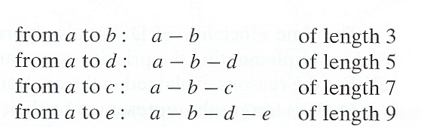
Dijkstra’s Algorithm Example

Slide 55
Dijkstra’s Algorithm
Analysis :
  Time efficiency depends on the data structure used for priority queue and for representing an input graph itself
  For graphs represented by their weight matrix and priority queue implemented as an unordered array, efficiency is in Ө(|V|²)
  For graphs represented by their adjacency list and priority queue implemented as a min-heap efficiency is in O(|E|log|V|)
  A better upper bound for both Prim and Dijkstra’s algorithm can be achieved, if Fibonacci heap is used

Slide 56
ROAD MAP
Greedy Technique
  Knapsack Problem
  Minimum Spanning Tree Problem
    Prim’s Algorithm
    Kruskal’s Algorithm
  Single Source Shortest Paths
    Dijkstra’s Algorithm
  Job Sequencing With Deadlines
  Huffman Trees
  Activity Selection Problem

Slide 57

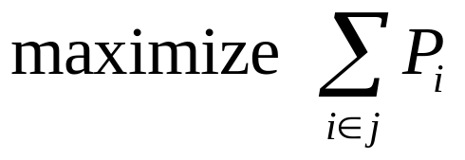
Job Sequencing With Deadlines
Given :
  n jobs 1, 2, … , n
  deadline d_{i} > 0 each job taken 1 unit time
  profit p_{i} > 0 1 machine available
Find
Feasibility:
The jobs in J can be completed before their deadlines
Optimality:

Slide 58
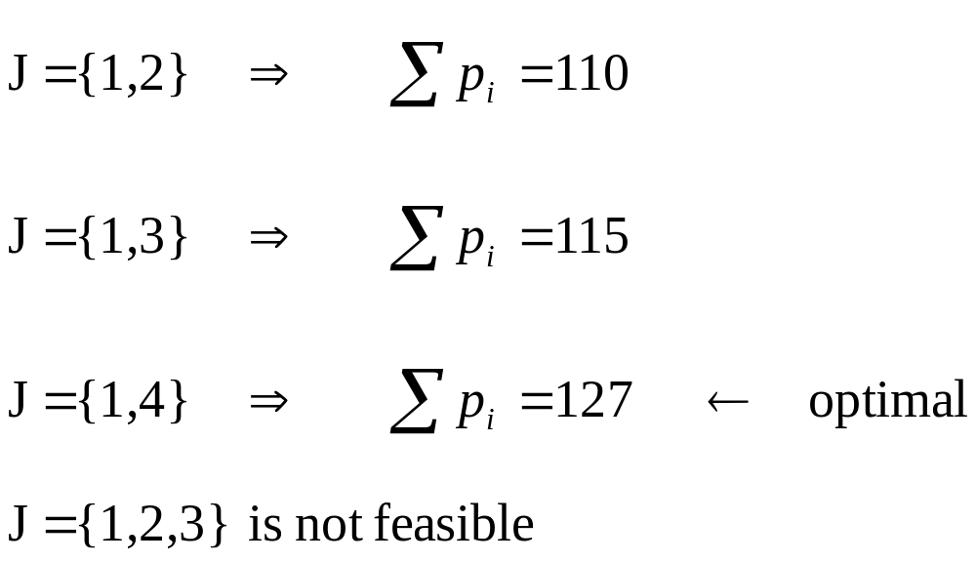
Job Sequencing With Deadlines
Example :
n = 4
d_{i} = 2, 1, 2, 1
p_{i} = 100, 10, 15, 27

Slide 59
Job Sequencing With Deadlines
Greedy strategy?

Slide 60
Job Sequencing With Deadlines
Greedy Choice :
Take the job gives largest profit
Process jobs in nonincreasing order of p_{i}’s

Slide 61
Greedy Technique
Greedy Algorithm ( a [ 1 .. N ] )
{
solution = Ø
for i = 1 to n
x = select (a)
if feasible ( solution, x )
solution = solution U {x}
return solution
}

Slide 62
Job Sequencing With Deadlines
How to check feasibility ?
Need to check all permutations
  k jobs than k! permutations
To check feasibility
  If the jobs are scheduled as follows
  i₁, i₂, …, i_{k}
  check whether
  d_{ij}, ≥ j
k jobs requires at least k! time
What about using a greedy strategy to check feasibility?

Slide 63
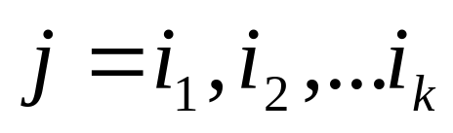
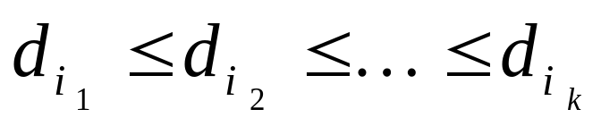
Job Sequencing With Deadlines
Order the jobs in nondecreasing order of deadlines
We only need to check this permutation
  The subset is feasible if and only if this permutation is feasible

Slide 64
Greedy Technique
Greedy Algorithm ( a [ 1 .. N ] )
{
solution = Ø
for i = 1 to n
x = select (a)
if feasible ( solution, x )
solution = solution U {x}
return solution
}

Slide 65
Job Sequencing With Deadlines
Analysis:
Use presorting
  Sorting and selection takes O(n log n) time in total
Checking feasibility
  Each check takes linear time in the worst case
  O(n²) in total
Total runtime is O(n²)
  Can we improve this?

Slide 66
ROAD MAP
Greedy Technique
  Knapsack Problem
  Minimum Spanning Tree Problem
    Prim’s Algorithm
    Kruskal’s Algorithm
  Single Source Shortest Paths
    Dijkstra’s Algorithm
  Job Sequencing With Deadlines
  Huffman Trees
  Activity Selection Problem

Slide 67
Encoding Text
Suppose we have to encode a text that comprises characters from some n-character alphabet by assigning to each of the text’s characters some sequence of bits called codeword
We can use a fixed-encoding that assigns to each character
  Good if each character has same frequency
  What if some characters are more frequent than others

Slide 68
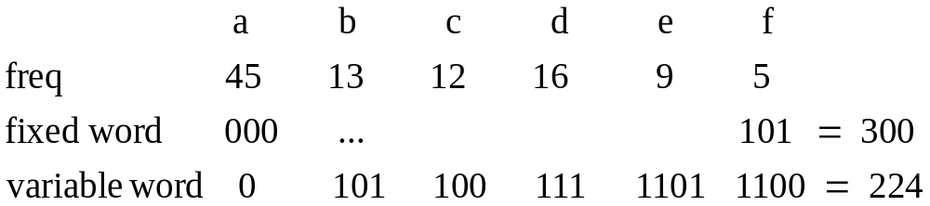
Encoding Text
EX: The number of bits in the encoding of 100 characters long text

Slide 69
Prefix Codes
A codeword is not prefix of another codeword
  Otherwise decoding is not easy and may not be possible
Encoding
  Change each character with its codeword
Decoding
  Start with the first bit
  Find the codeword
    A unique codeword can be found – prefix code
  Continue with the bits following the codeword
Codewords can be represented in a tree

Slide 70
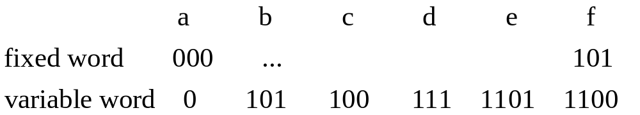
Prefix Codes
EX: Trees for the following codewords…

Slide 71
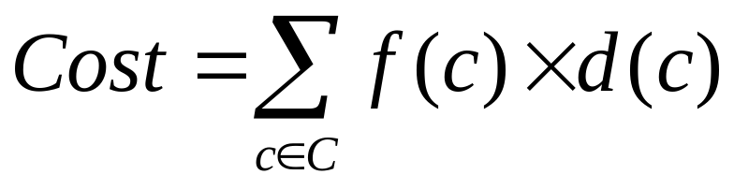
Huffman Codes
Given: The characters and their frequencies
Find: The coding tree
Cost : Minimize the cost
  f(c) : frequency of c
  d(c) : depth of c

Slide 72
Huffman Codes
What is the greedy strategy?

Slide 73
Huffman Codes
Approach :
  1. Q = forest of one-node trees
  // initialize n one-node trees;
  // label the nodes with the characters
  // label the trees with the frequencies of the chars
  2. for i=1 to n-1
  3. x = select the least freq tree in Q & delete
  4. y = select the least freq tree in Q & delete
  5. z = new tree
  6. z→left = x and z→right = y
  7. f(z) = f(x) + f(y)
  8. Insert z into Q

Slide 74
Greedy Technique
Greedy Algorithm ( a [ 1 .. N ] )
{
solution = Ø
for i = 1 to n
x = select (a)
is feasible ( solution, x )
solution = solution U {x}
return solution
}

Slide 75


Huffman Codes Example
Consider five characters {A,B,C,D,-} with following occurrence probabilities
The Huffman tree construction for this input is as follows

Slide 76
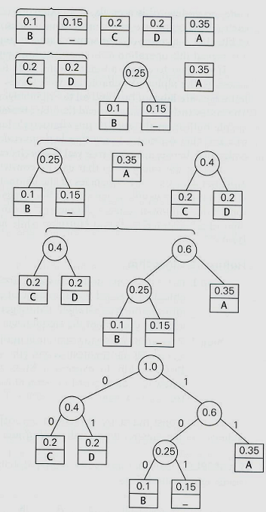

Slide 77
Huffman Codes
Optimality Proof :
  Tree should be full
  Two least frequent chars x and y must be two deepest nodes
  Induction argument
    After merge operation → new character set
      Characters in roots with new frequencies

Slide 78
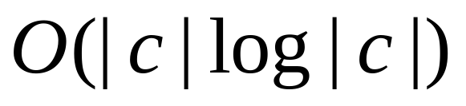
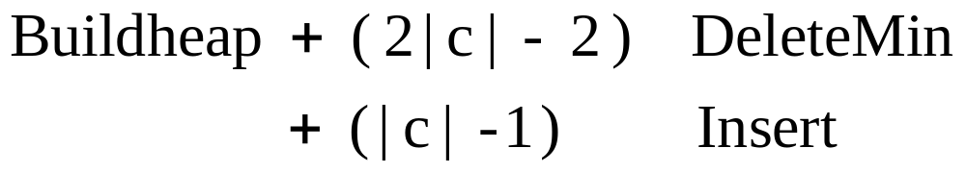
Huffman Codes
Analysis :
  Use priority queues for forest

